Slide 1
Smartfarm_agent:An ai agent for smart farming advice using ibm watsonx
CAPSTONE PROJECT
Presented By:
Student name:Kundam Yaswanth Chandra Gupta-College:Saveetha College of Liberal Arts and Sciences(SIMATS)-Department:BCA

Slide 2
OUTLINE
Problem Statement (Should not include solution)
Proposed System/Solution
System Development Approach (Technology Used)
Deployment
Result (Output Image)
Conclusion
Future Scope
References

Slide 3
Problem Statement
Small-scale farmers often lack access to timely, reliable agricultural information in their local language. This results in poor decisions related to crop selection, weather preparedness, pest control, and market pricing leading to reduced productivity and income. There is a need for an AI-based solution that provides real-time, localized, and easy-to-understand farming advice to support informed decision-making and sustainable agriculture.

Slide 4
Proposed Solution
The proposed system provides smart, real-time agricultural guidance to farmers using Retrieval-Augmented Generation (RAG) and language models. The AI agent helps answer farming-related queries accurately by leveraging trusted external data sources
.Data Collection:
Retrieve real-time data on weather,soil,crop suitability,pests alerts,and many prices.
Sources include meterogical APIs,agri-tech platforms,and agricultural databases.
Data Preprocessing:
Clean and filter retrieved data for relevance and accuraccy
Translate or simplify technical terms into farmer-friendly language.
AI Agent(RAG+LLM):
Use a large language model integrated with retrieval tools.
Architecture:LangGraph + ReAct,enabling reasoning and tool-based search.
Tool integration:tools like Google Search,Wheather,Wikipedia and Webcrawler are used to fetch accurate,updated answers.
Deployment:
Agent is built using IBM watsonx Agent Lab.
User can interact with the agent through a simple chatbot interface.
Expected Outcome:
Personalized advice based on user queries like:
What crop should I grow this season?

Slide 5
System Approach
This section outlines the overall strategy and components used to build the Smart Farming Agent powered by Retrieval-Augmented Generation (RAG).
🔹 System Requirements:
IBM watsonx.ai – For agent creation and deployment
Web Browser – To access the agent
Internet Connection – To retrieve real-time agricultural data
🔹 Libraries / Tools Used:
LangGraph – To create a reasoning framework for the agent
ReAct Architecture – To handle retrieval + reasoning steps
Google Search Tool – For live data search
Weather Tool – For climate-based crop suggestions

Slide 6
Deployment
The SmartFarm_Agent is deployed using IBM watsonx.ai Agent Lab, a cloud-based environment that allows easy development and execution of AI agents without the need for manual server setup.
🔹 Deployment Highlights:
Platform: IBM watsonx.ai (cloud-hosted)
Interface: Web-based agent interface for real-time user interaction
Tools Integrated: Google Search, Weather API, Wikipedia, etc.
Always Live: The system responds to user queries instantly using Retrieval-Augmented Generation (RAG)
This deployment approach ensures high availability, low maintenance, and accessibility from anywhere with internet access.

Slide 7
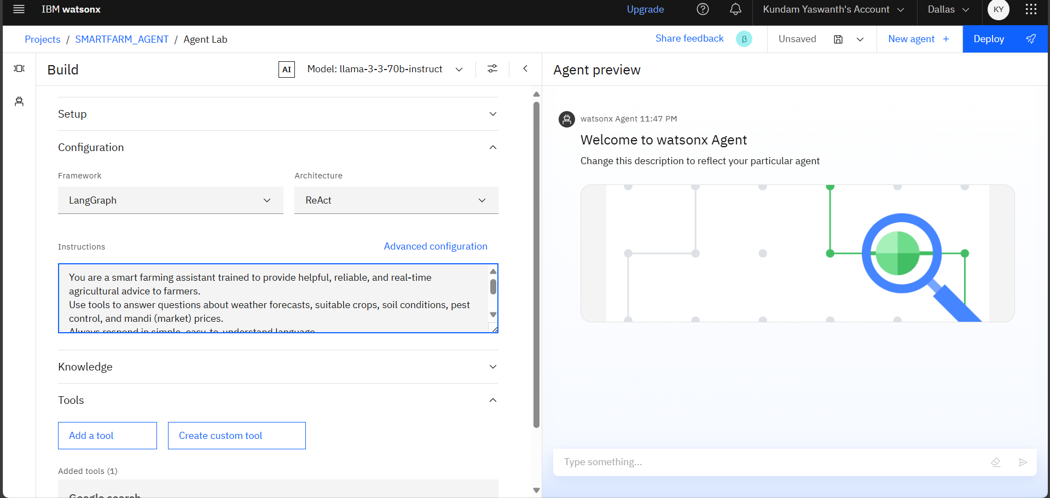
Result
This image shows the configuration of an AI agent using LangGraph and ReAct in Watsonx. The agent is trained to assist farmers with real-time advice on weather, crops, soil, pests, and mandi prices.

Slide 8
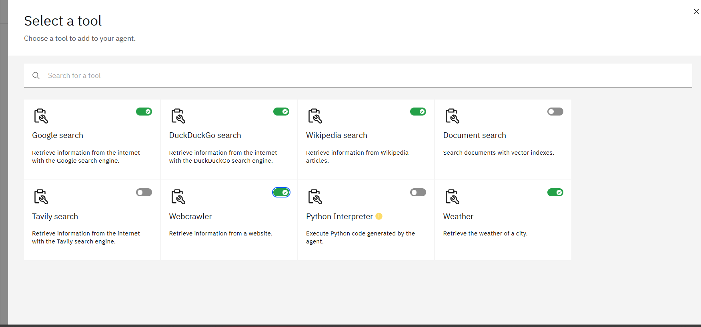
Result
The agent is equipped with tools like Google Search, Wikipedia, Weather, and Webcrawler to provide real-time agricultural information and decision support for farmers.

Slide 9
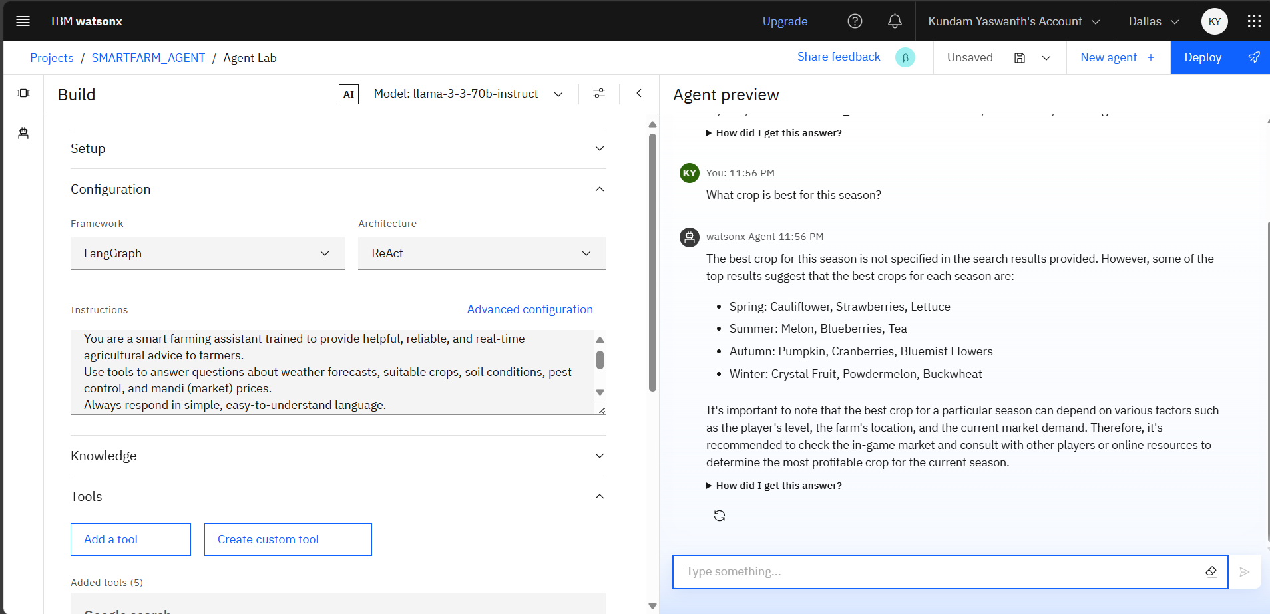
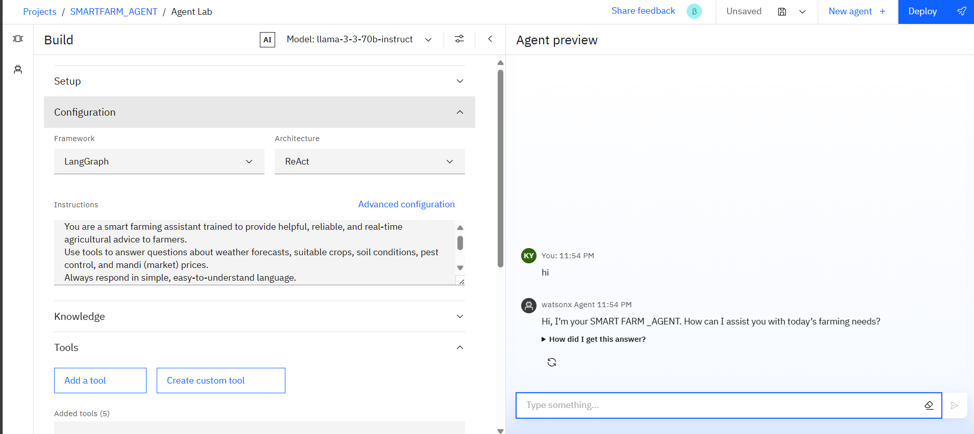
Result
The above images shows that the ai agent has given answers according to our instructions.

Slide 10
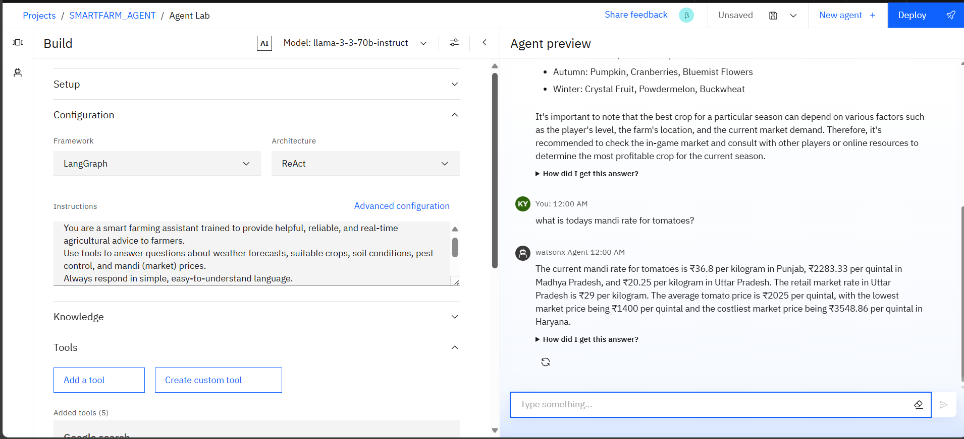
Result

Slide 11
Conclusion
The Smart Farming AI Agent, powered by Retrieval-Augmented Generation (RAG), effectively addresses the information gap faced by small-scale farmers. By providing real-time, localized, and reliable agricultural advice, the agent empowers farmers to make informed decisions about crop selection, pest control, weather preparedness, and market pricing.
This AI-driven solution enhances productivity, reduces risk, and improves income, bringing the benefits of smart farming to the grassroots. With multi-language support and easy access, it stands as a powerful step toward sustainable and inclusive agricultural development.

Slide 12
Future scope
Voice-Based Interaction Add support for voice queries in local languages to improve accessibility for non-tech-savvy farmers.
Mobile Application Develop a mobile app version to ensure on-the-go access for farmers in remote areas.
Expansion to Livestock and Fisheries Extend the AI agent’s capabilities to provide guidance for animal husbandry and aquaculture.
Offline Capabilities Build offline support where limited internet connectivity exists, using periodic data syncing.

Slide 13
References
IBM watsonx.ai Documentation
IBM watsondx.ai Agent Lab Tutorials
FAO:Smart Farming Techniques.

Slide 14
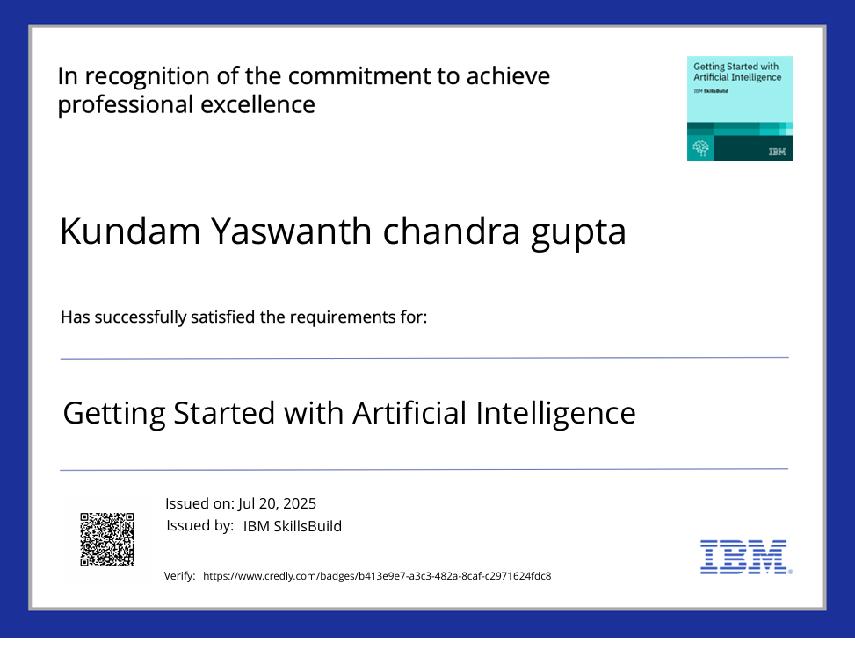
IBM Certifications
Screenshot/ credly certificate( getting started with AI)

Slide 15
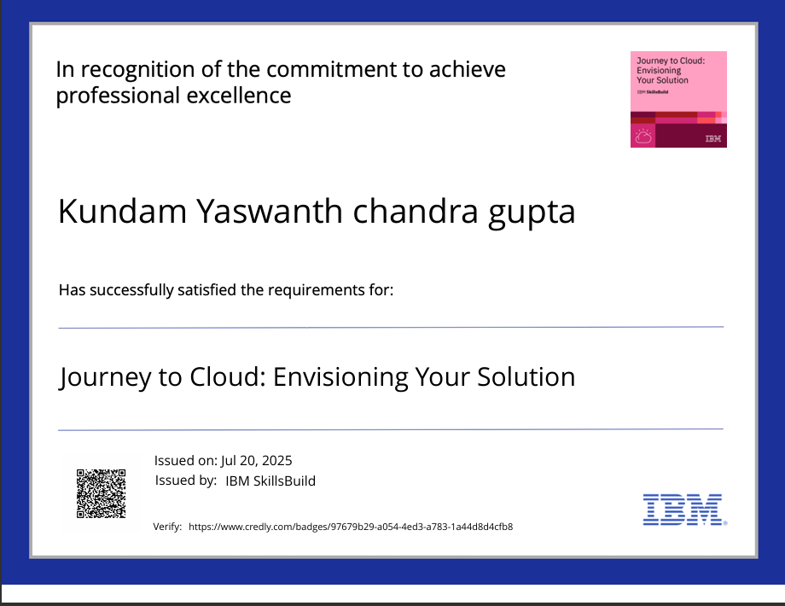
IBM Certifications
Screenshot/ credly certificate( Journey to Cloud)

Slide 16
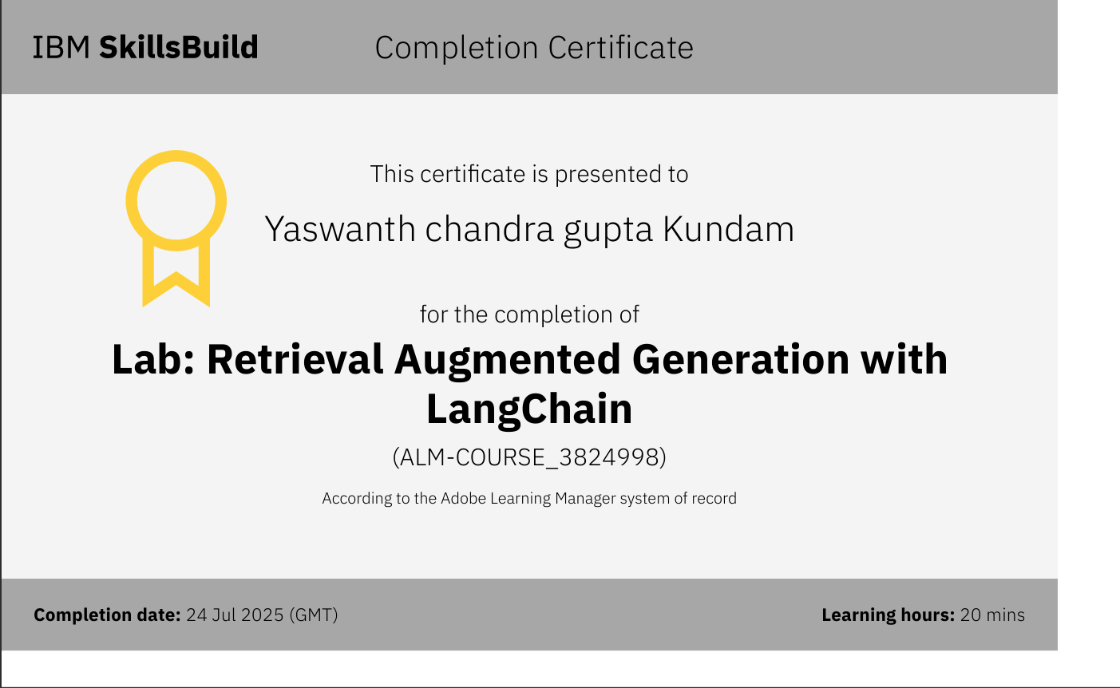
IBM Certifications
Screenshot/ credly certificate( RAG Lab)

Slide 17
THANK YOU

